Slide 1
European Studies and the Study of Europe in a Global Context
at Osnabrueck University

Slide 2
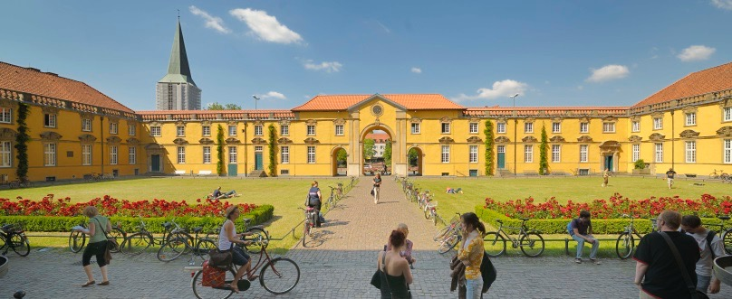
European Studies
at Osnabrueck University
Past
Present
Future

Slide 3
European Studies
at Osnabrueck University
Past
Founded in 1974 as a 'Reform' University for regional needs
Extension of existing university for teachers education into full university, teachers education remains central element
Faculties organized as interdisciplinary 'clusters'
Strong social studies dimension in the humanities

Slide 4
European Studies
at Osnabrueck University
Past
General diversification: strengthening of natural sciences, law, psychology
in the humanities: Focus on Migration Studies and Europe
1994: Graduate School / Doctoral Program concerned with European issues and European identity (political, social, cultural)
1995: Founding of Institute for Migration and Intercultural Studies (IMIS)
2007: Jean Monnet Center for Excellence in European Studies

Slide 5
European Studies
at Osnabrueck University
Past
1990 German reunification => realignment and reassessment of national (internal) and European (external) identity and role
1999 'Bologna Reform' => alignment of study programs and degrees across Europe to enhance student mobility and employment options

Slide 6
European Studies
at Osnabrueck University
Past
new study programs, esp. new B.A. programs enforce massive redistribution of resources within faculties (teaching personell, budgets)
gradual separation of social/political science programs concerned with Europe (B.A. program in 'European Studies') and complementary studies in the humanities (after 2004 all B.A. programs in languages and literatures are focused on teachers education)

Slide 7
European Studies
at Osnabrueck University
Present
after attempts (in 2005-6) to build a common masters program in European studies between the social sciences and the humanities fail, the social sciences develop a proprietary B.A. program to be completed with a M.A. program in 'European Governance'
in 2007 the faculty of languages and literatures starts to develop two new M.A. programs with a focus on Europe: "European Cultures and Literatures" (literary and cultural studies) and "Language in Europe" (in linguistics)
both programs are meant as complements to the social science programs and have turned into the faculty’s most attractive M.A. programs

Slide 8
European Studies
at Osnabrueck University
Present
"Literatur und Kultur in Europa" - literatures and cultures in Europe introduced as M.A. program in 2010
2 years / 4 semesters course of studies, meant to build on a B.A. program in the humanities, including history, media studies, social/political sciences, even legal studies or cultural geography
strong focus on languages (at least two, better three European languages) and (inter-)cultural studies => culture as identity

Slide 9
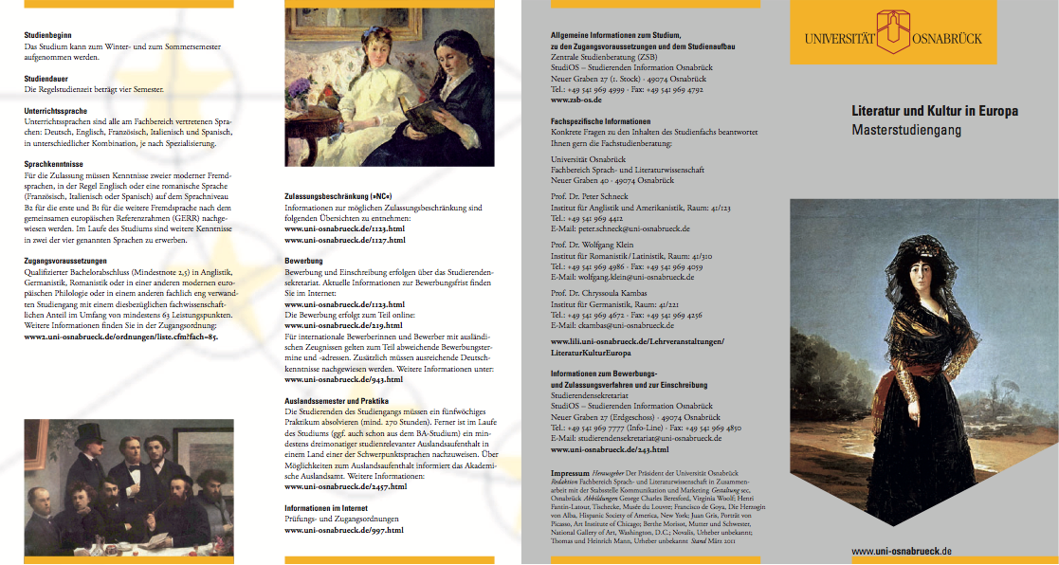
European Studies
at Osnabrueck University
Present

Slide 10
European Studies
at Osnabrueck University
Present
"Literatur und Kultur in Europa" : the Study of Europe in an International / Global Context

Slide 11
European Studies
at Osnabrueck University
Present - M.A. "European Literatures and Cultures"
Central premises
Europe is less an existing political entity than a motivating cultural idea
the idea of Europe precedes the historical formation of nation states / national cultures and identities from the 17th Century onward, but is inevitably connected to this formation
the perspective of the (critical and cultural) study of Europe has to be extended to include international and global contexts and the role that (the idea of) Europe plays in these contexts
language and culture are both forces of difference and integration

Slide 12
European Studies
at Osnabrueck University
Present - M.A. "European Literatures and Cultures"
Program elements
4-6 modules (two / three seminar units) in literary and cultural studies, at least two of them in different languages / literatures / cultures, one module must cover two languages (inter-cultural module)
at least 4 courses in language practice in at least two different languages
an internship, preferably in an international setting, or an internship and at least three months work or study in an international setting
at least 6 courses from other disciplines, such as history, social/political science, art history, economics, music, psychology => autonomous interdisciplinary studies
oral exams, a masters thesis or a project (e.g. exhibition, theatre performance, book project etc.)

Slide 13
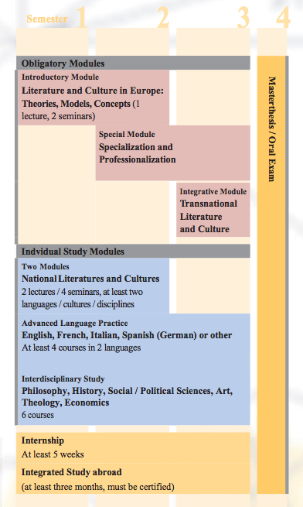
M.A. Program "Literatures and Cultures in Europe"
Program structure and modules

Slide 14
European Studies
at Osnabrueck University
Present - M.A. "European Literatures and Cultures"
Students and objectives
most students come from the humanities, are interested in languages and have some prior training / interest in cultural studies
many try to maintain their interdisciplinary perspectives and want to study more than one language ('Monomaster' versus 'Quermaster')
a high number are either international students or students who want to work internationally
attempt to balance professional training with academic / scientific competences
cooperation with cultural institutions, regional, national and international (e.g. theatre, media, cultural management, Goethe Institute)

Slide 15
European Studies
at Osnabrueck University
Future - expansion and reach out
three major objectives
expand international and interdisciplinary aspects of the program
increase collaboration with universities in European and global context (program exchanges, dual degree programs, student and staff exchange)
extending and shaping internal cooperation and exchange with other disciplines and institutes - European studies: Jean Monet Center for Excellence in European Studies, IMIS, but also integrating interdisciplinary projects and research interests in the faculty: Human Rights, cultural legal studies, translation studies, cultural cognition etc.

Slide 16
Thank you – ¡Muchas Gracias!

